Slide 1
Renewable sources, nuclear power, and energy storage alternatives to reduce UIUC Campus CO2 emissions
Roberto Fairhurst Agosta
ref3@illinois.edu
NPRE 498 - Energy Storage - Spring 2021
University of Illinois at Urbana-Champaign

Slide 2
Objectives
Propose electricity generation alternatives for decreasing CO2 emissions on UIUC campus.
Objective aligned with Illinois Climate Action Plan (iCAP) objectives.
Understand the components of UIUC campus grid.
Determine current CO2 emissions in two representative months of the year.
Calculate CO2 emissions for different scenarios, including:
Increase in wind generation capacity.
Increase in solar generation capacity.
Addition of a nuclear reactor to UIUC campus grid.
Compare different electricity storage alternatives.

Slide 3
iCAP [1]
American College and University Presidents’ Climate Commitment (2008)
Become carbon neutral as soon as possible, no later than 2050.
Development of the iCAP (2010)
Comprehensive roadmap toward a sustainable campus.
iCAP list of goals, objectives, and potential strategies for several topical areas:
Energy Conservation and Building Standards
Energy generation, Purchasing, and Distribution
Transportation
Water and Stormwater usage
Purchasing, Waste, and Recycling (Zero Waste)
Agriculture, Land Use, Food, and Sequestration

Slide 4
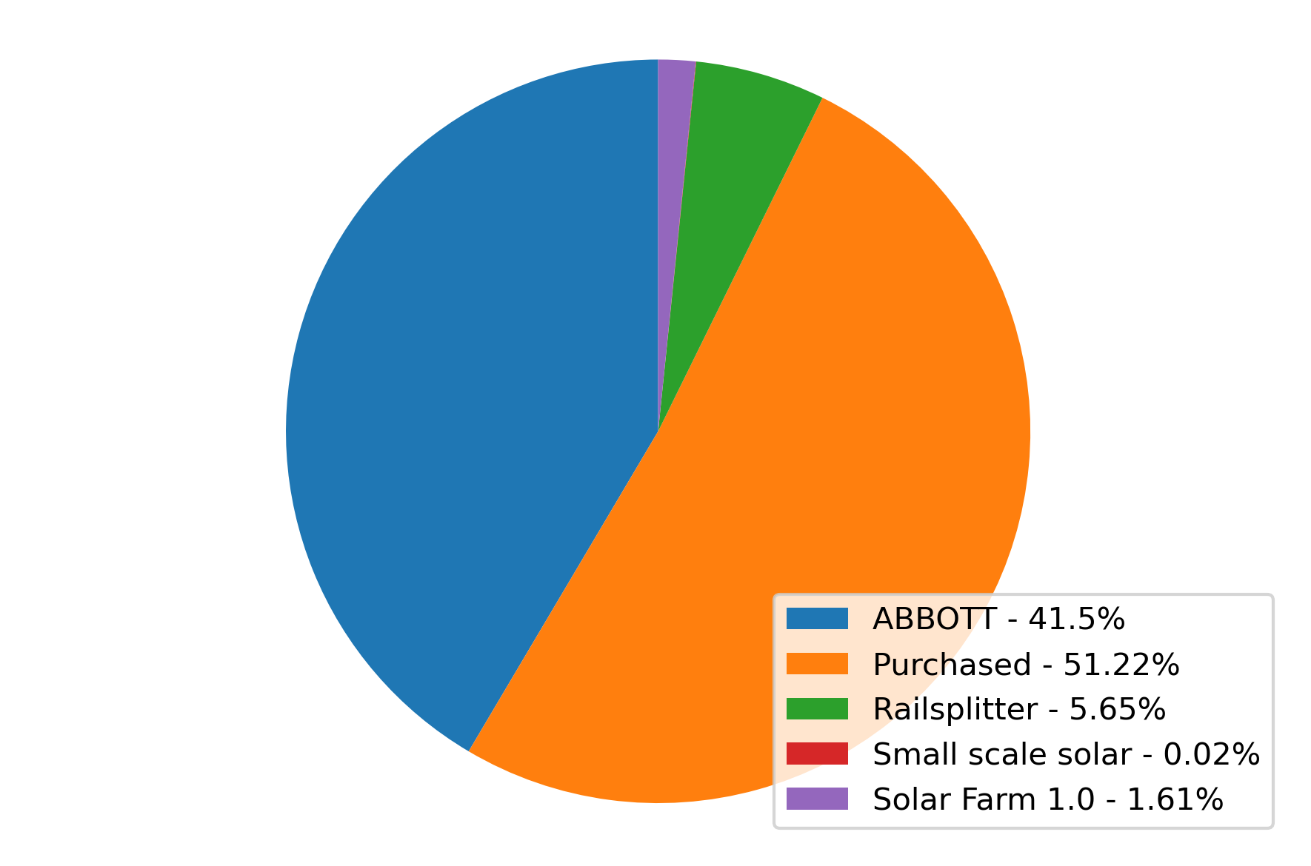
UIUC Campus Grid [2]
Figure. FY19 Electricity generation distribution.

Slide 5
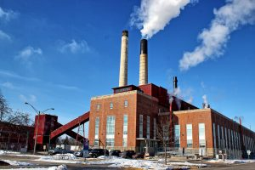
ABBOTT Power Plant [3-4]
Built in 1941.
Supplies 70-75% of the campus energy demand.
Types of energy sources:
Two gas turbines (natural gas or fuel oil)
Three gas-fired boilers (natural gas or fuel oil)
Three coal-fired boilers
Cogeneration facility: steam and electricity
High-pressure steam spins a turbine to drive a generator and produce electricity.
Low-pressure exhaust steam for space heating, water heating, and space cooling.
Electrical capacity 85 MW.
Free tours.

Slide 6
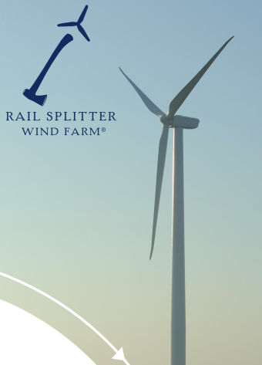
Rail Splitter Wind Farm [5-6]
Operation began in 2009.
Located in Tazewell and Logan Counties.
Power output: 100.5 MW.
67 turbines of 1.5 MW.
Power purchase agreement:
November 2016 - October 2026
8.6% of the total wind generation

Slide 7
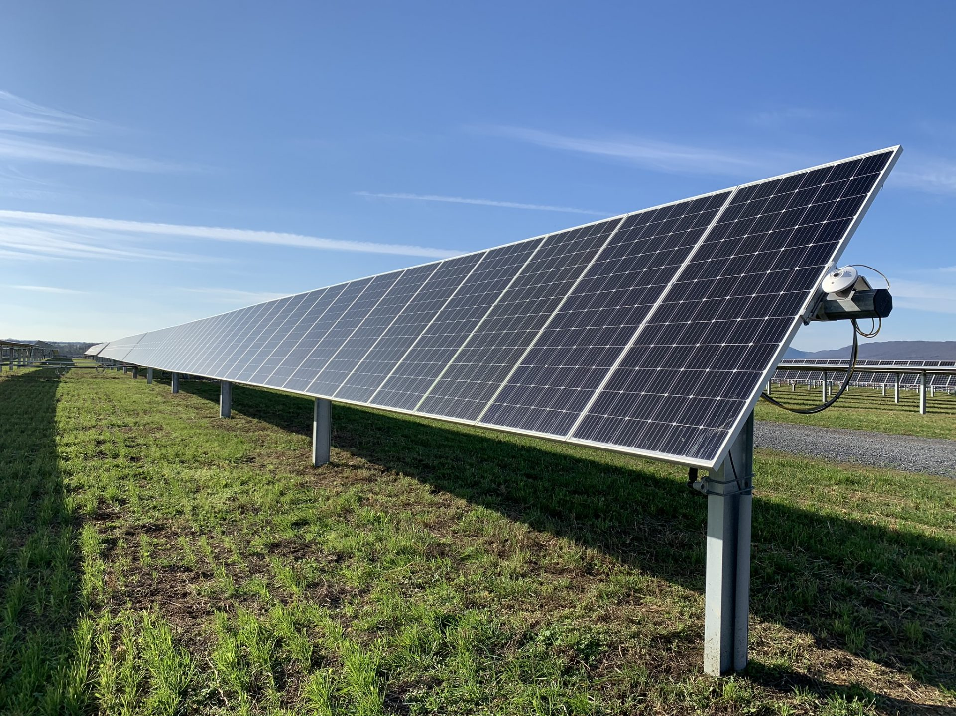
Solar Farm 1.0 [7-8]
Operation began in 2015.
Power output: 4.68 MWac.
Total modules: 18,867.
Land usage: 20.8 acres.
Power purchase agreement: 2015-2025.
Solar Farm 2.0: 12.32 MWdc, 54 acres.

Slide 8
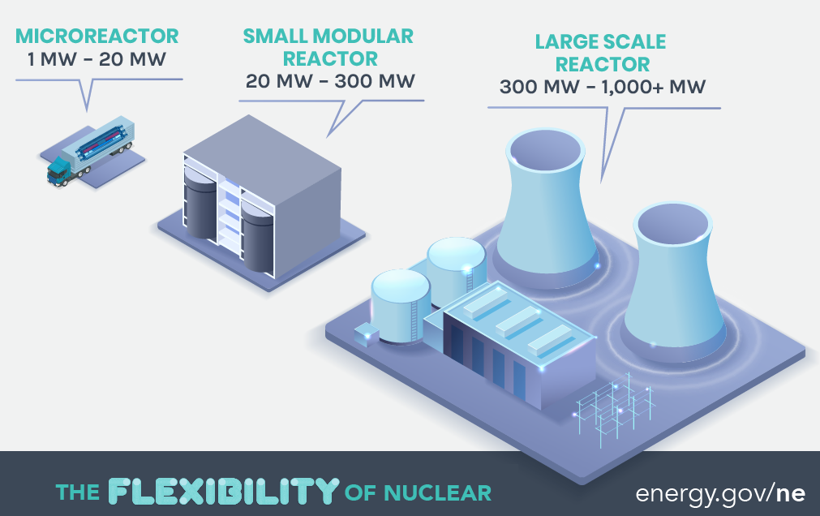
Small Modular Reactors and Microreactors [9-10]
UIUC Grid demand < 80 MW.
Limited on-site preparation requirements.
Factory-fabricated components.
Components shipped out to generation site.
Black starts and islanding operation mode.
Passive safety systems, minimizing electrical parts.

Slide 9
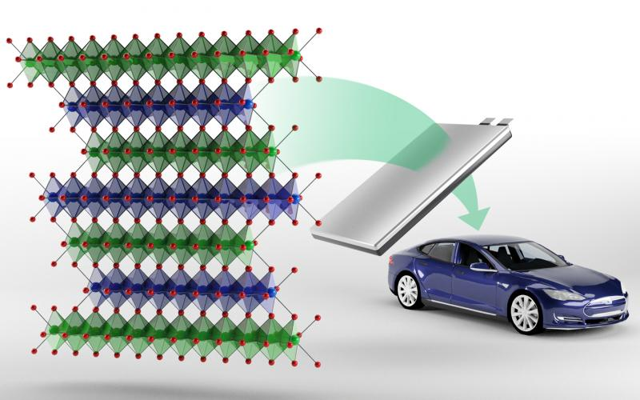
Li-ion Batteries [11-15]
Charge-Discharge Efficiency: 80-90%
Rechargeable battery
First prototype developed in 1985
High energy density and low self-discharge
Can cause explosions and fires
Capacity fading over hundreds to thousands of cycles
Applications:
Portable Power Packs: Laptops and cellphones
Electric Vehicles (EVs)
Uninterruptible Power Supply (UPS): computers, communication technology, medical technology
Solar power storage
World largest Li-ion: 150 MW

Slide 10
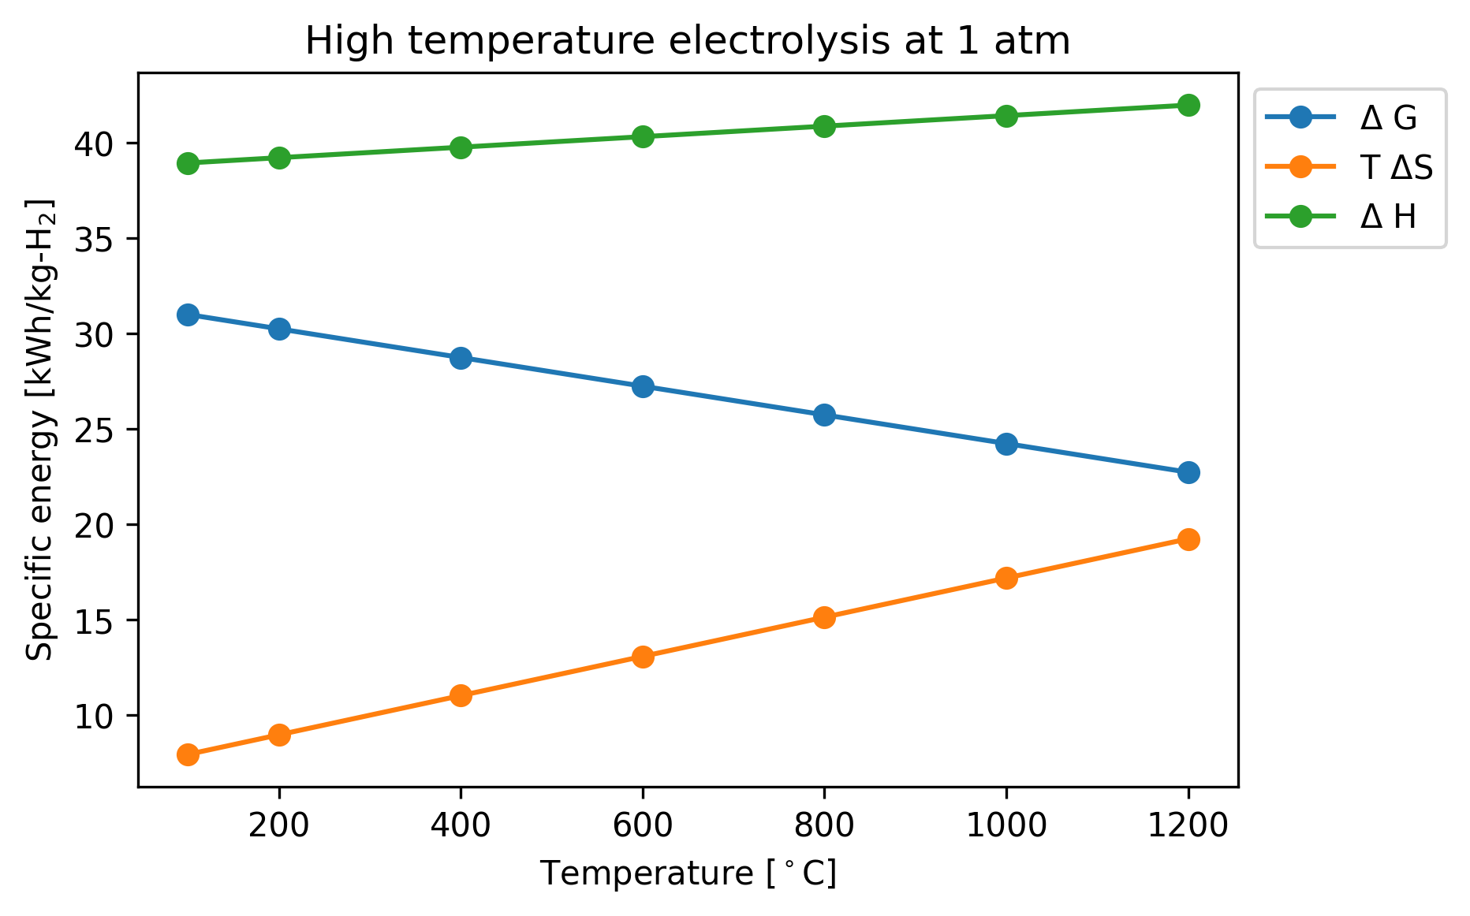
Electrolysis [16]
Commercial use since 1890.
Most common technologies:
Alkaline-based
Proton exchange membrane (PEM)
Solid Oxide (SOEC)
Low temperature electrolysis (LTE)
High temperature electrolysis (HTE)
Equation:
𝚫H = 𝚫G + T𝚫S
𝚫H: Specific total energy
𝚫G: Specific electrical energy
T𝚫S: Specific thermal energy

Slide 11
Scenario 0 - Business as usual
Wind
We will focus in a summer month (June) and a winter month (January)
Data available from F&S per request [17]
Abbott: 0.26 tCO2/MW(th)h [1-2]
Imports: 0.825 tCO2/MWh [1-2]
Solar
Demand
Abbott
Import

Slide 12
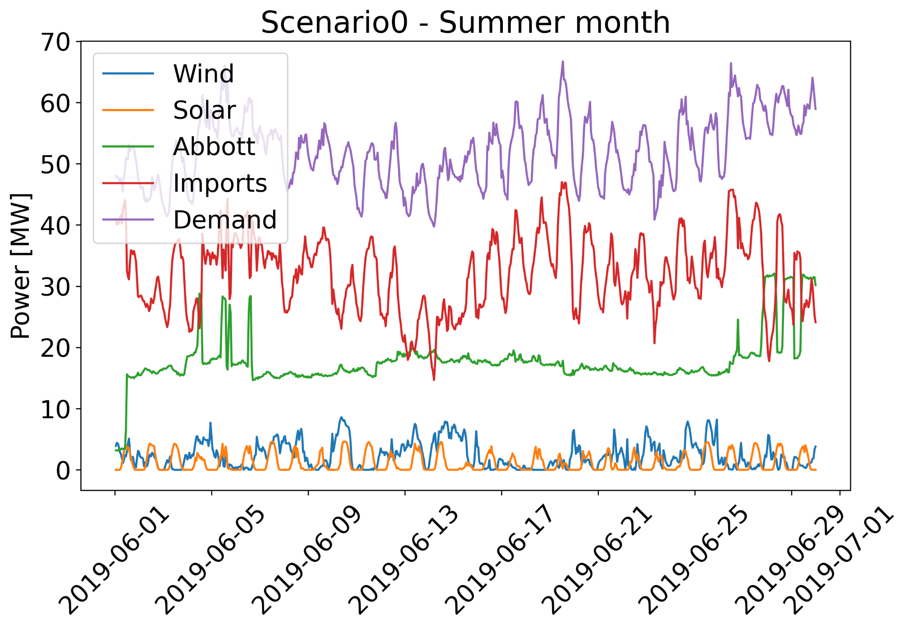
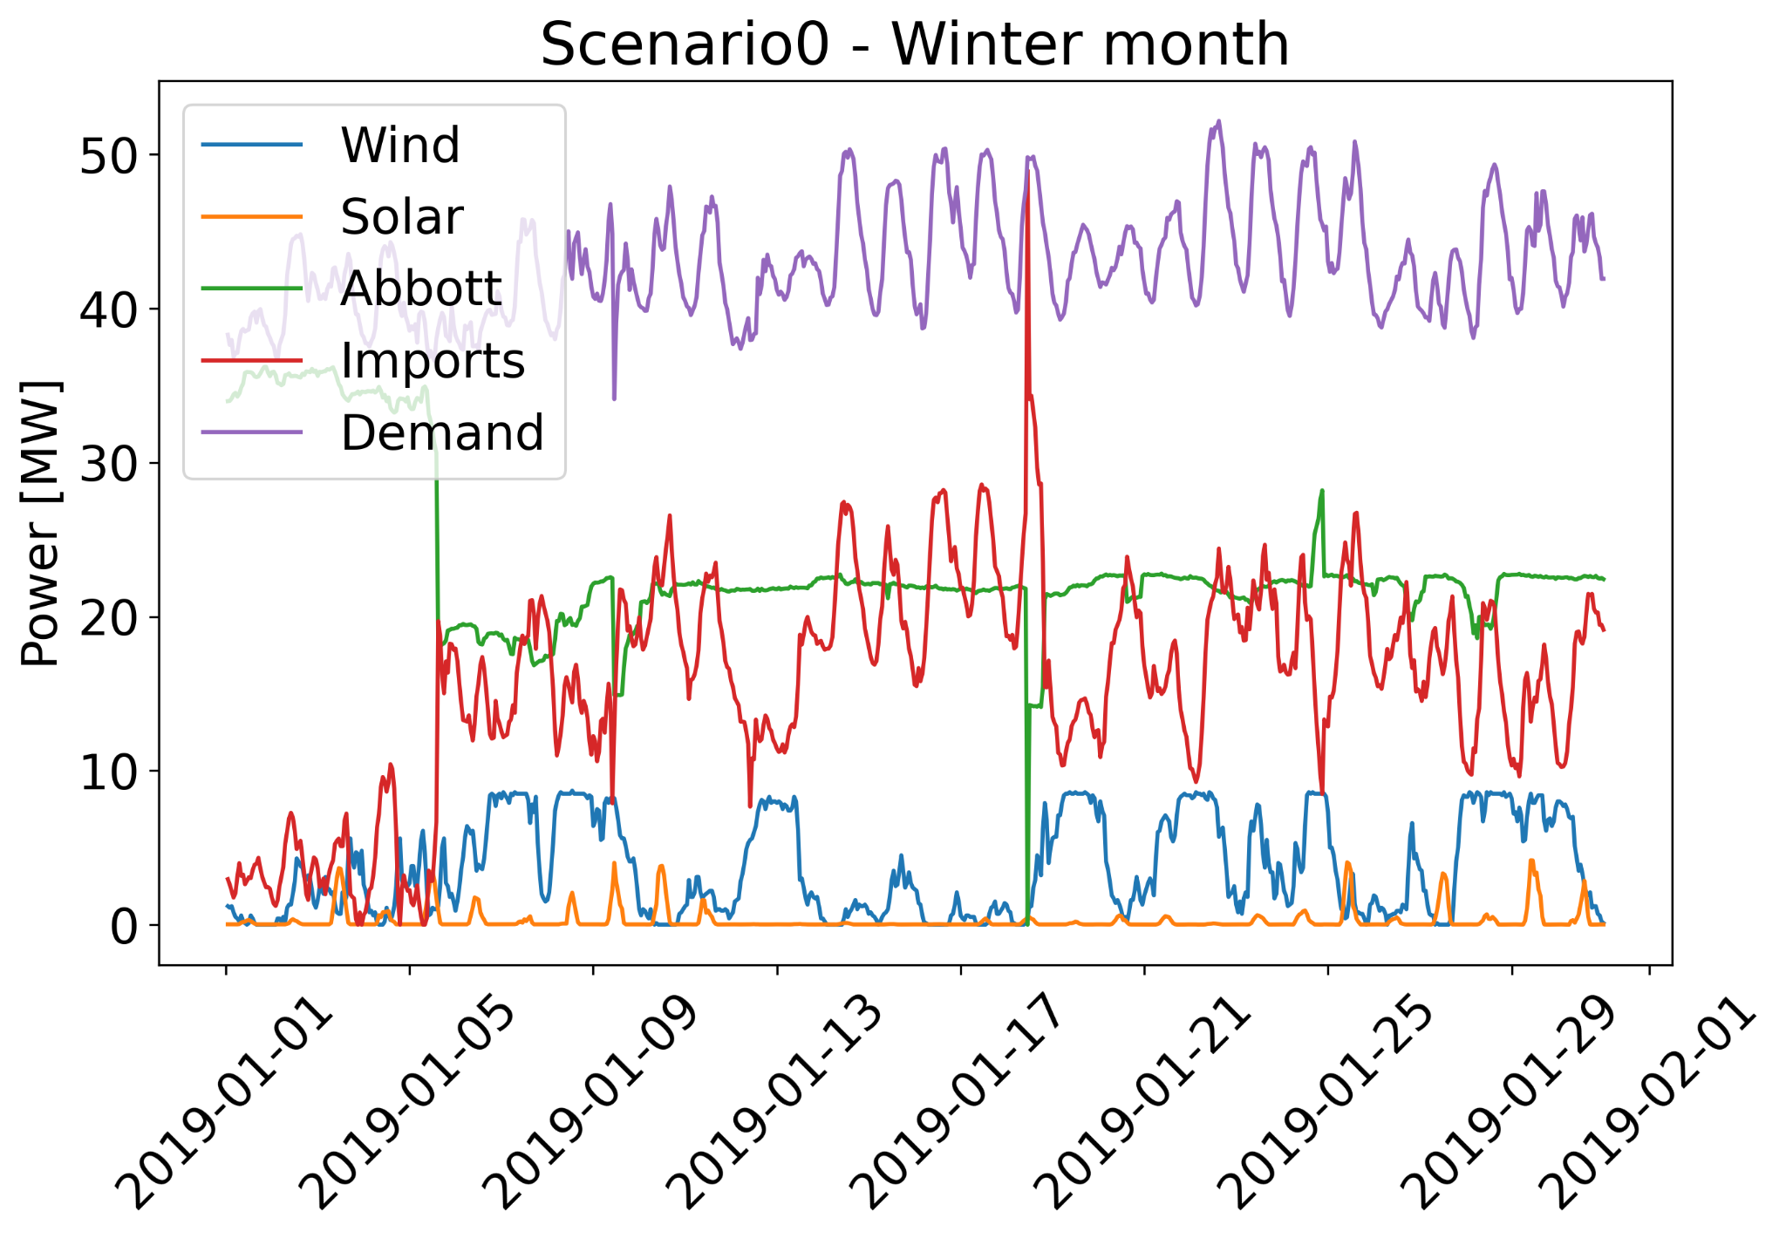
Scenario 0 - Results
10³ MT CO₂ | Abbott | Imports | Total
Winter | 6.6 | 8.5 | 15.1
Summer | 4.8 | 16.7 | 21.5

Slide 13
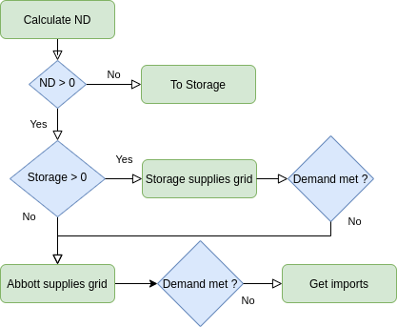
Scenario 1
Dispatch model
Wind and Solar
Storage
Abbott
Import
Increase in Wind and Solar capacity
Net Demand (ND) = Demand - Wind - Solar
Necessity for storage mechanisms

Slide 14
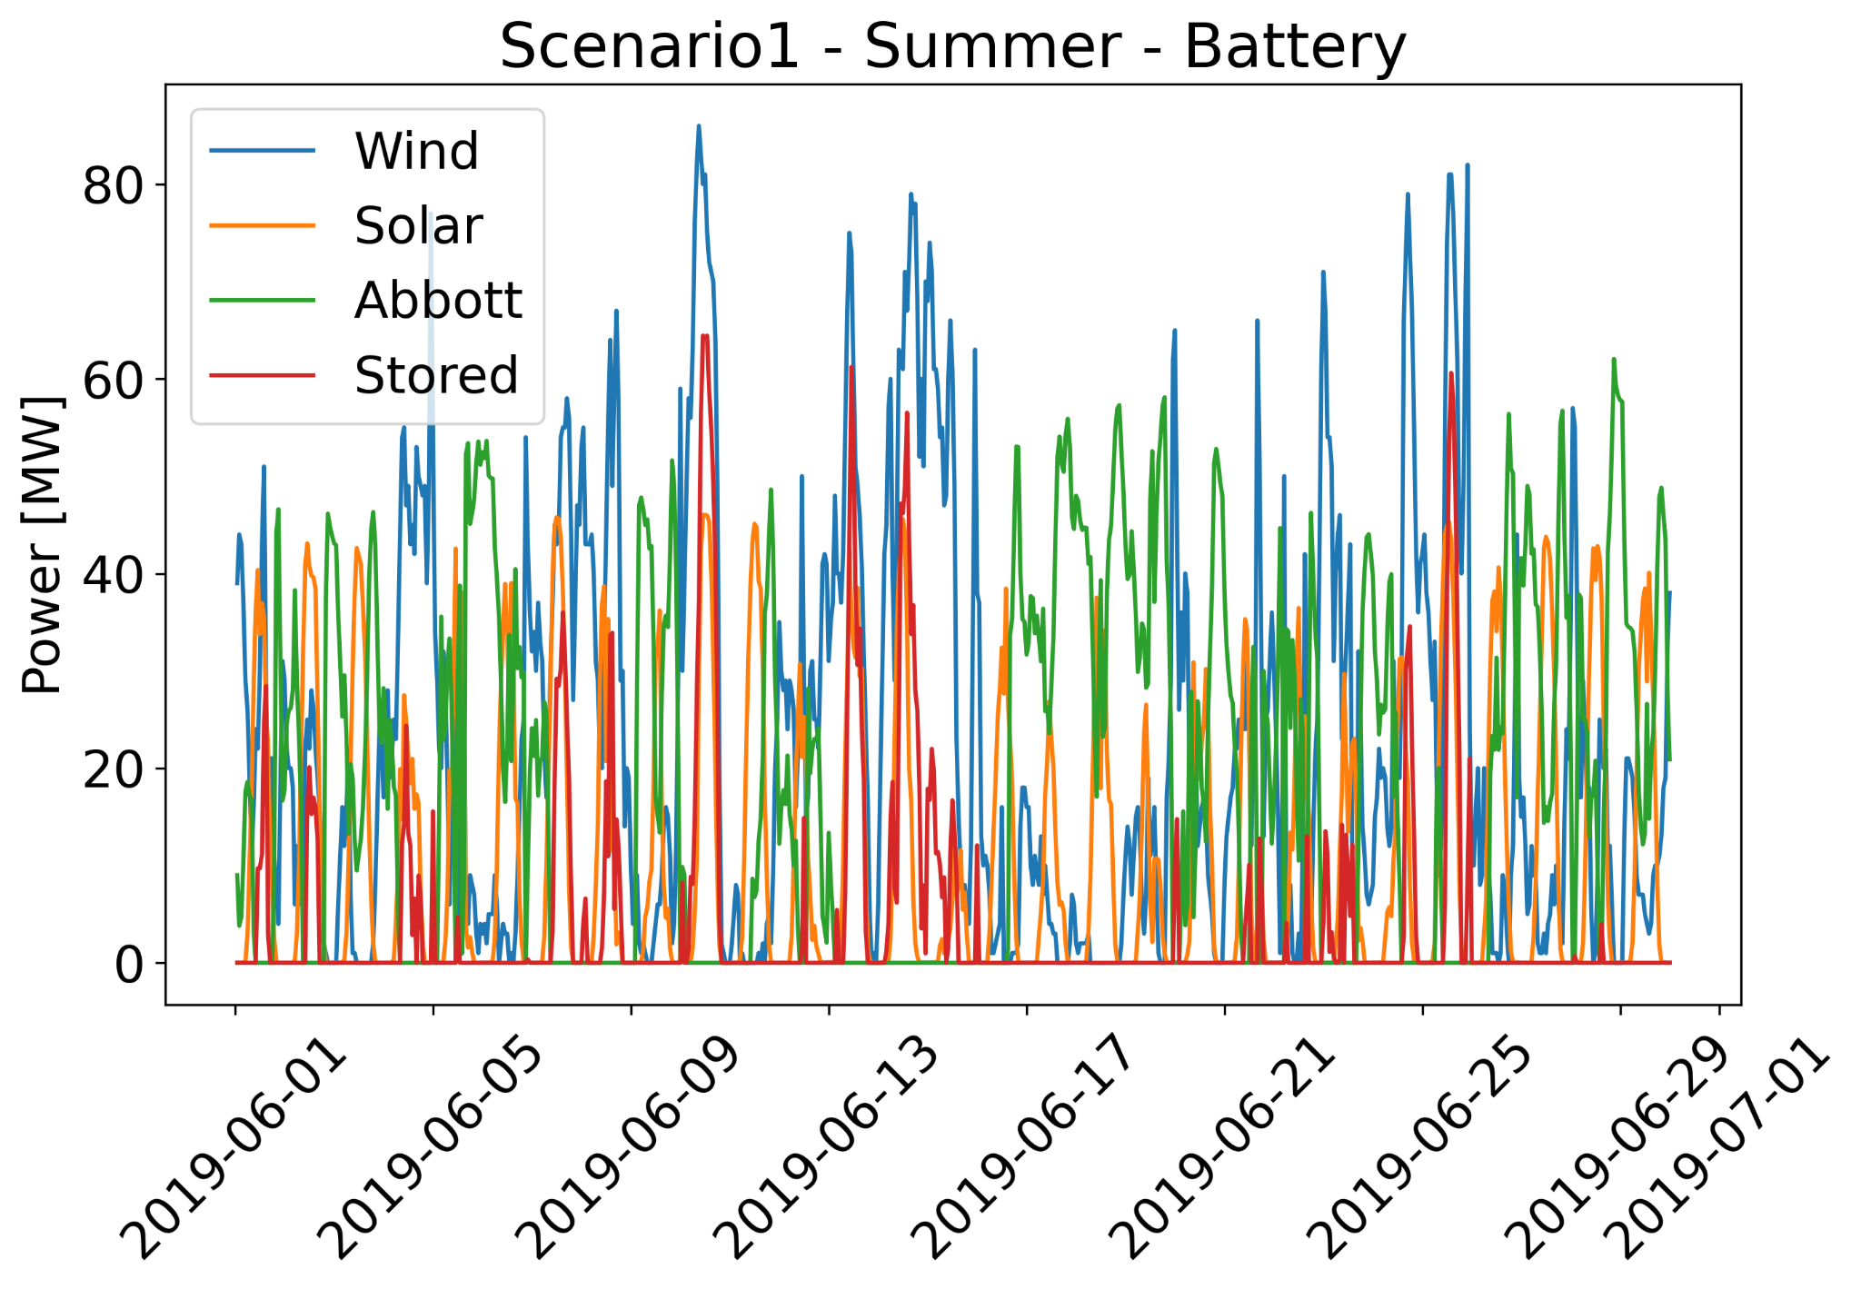
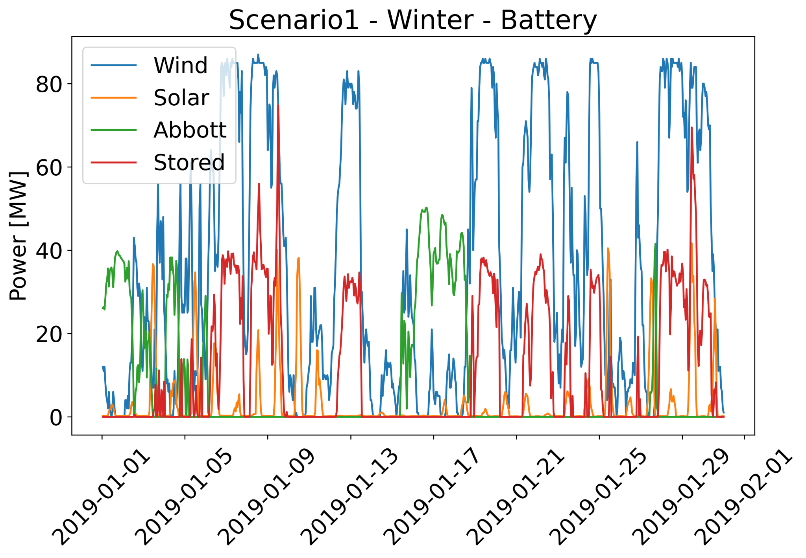
Scenario 1 - Results
Capacity increase by 10, Wind: 100.5 MW, Solar: 46.8 MW

Slide 15
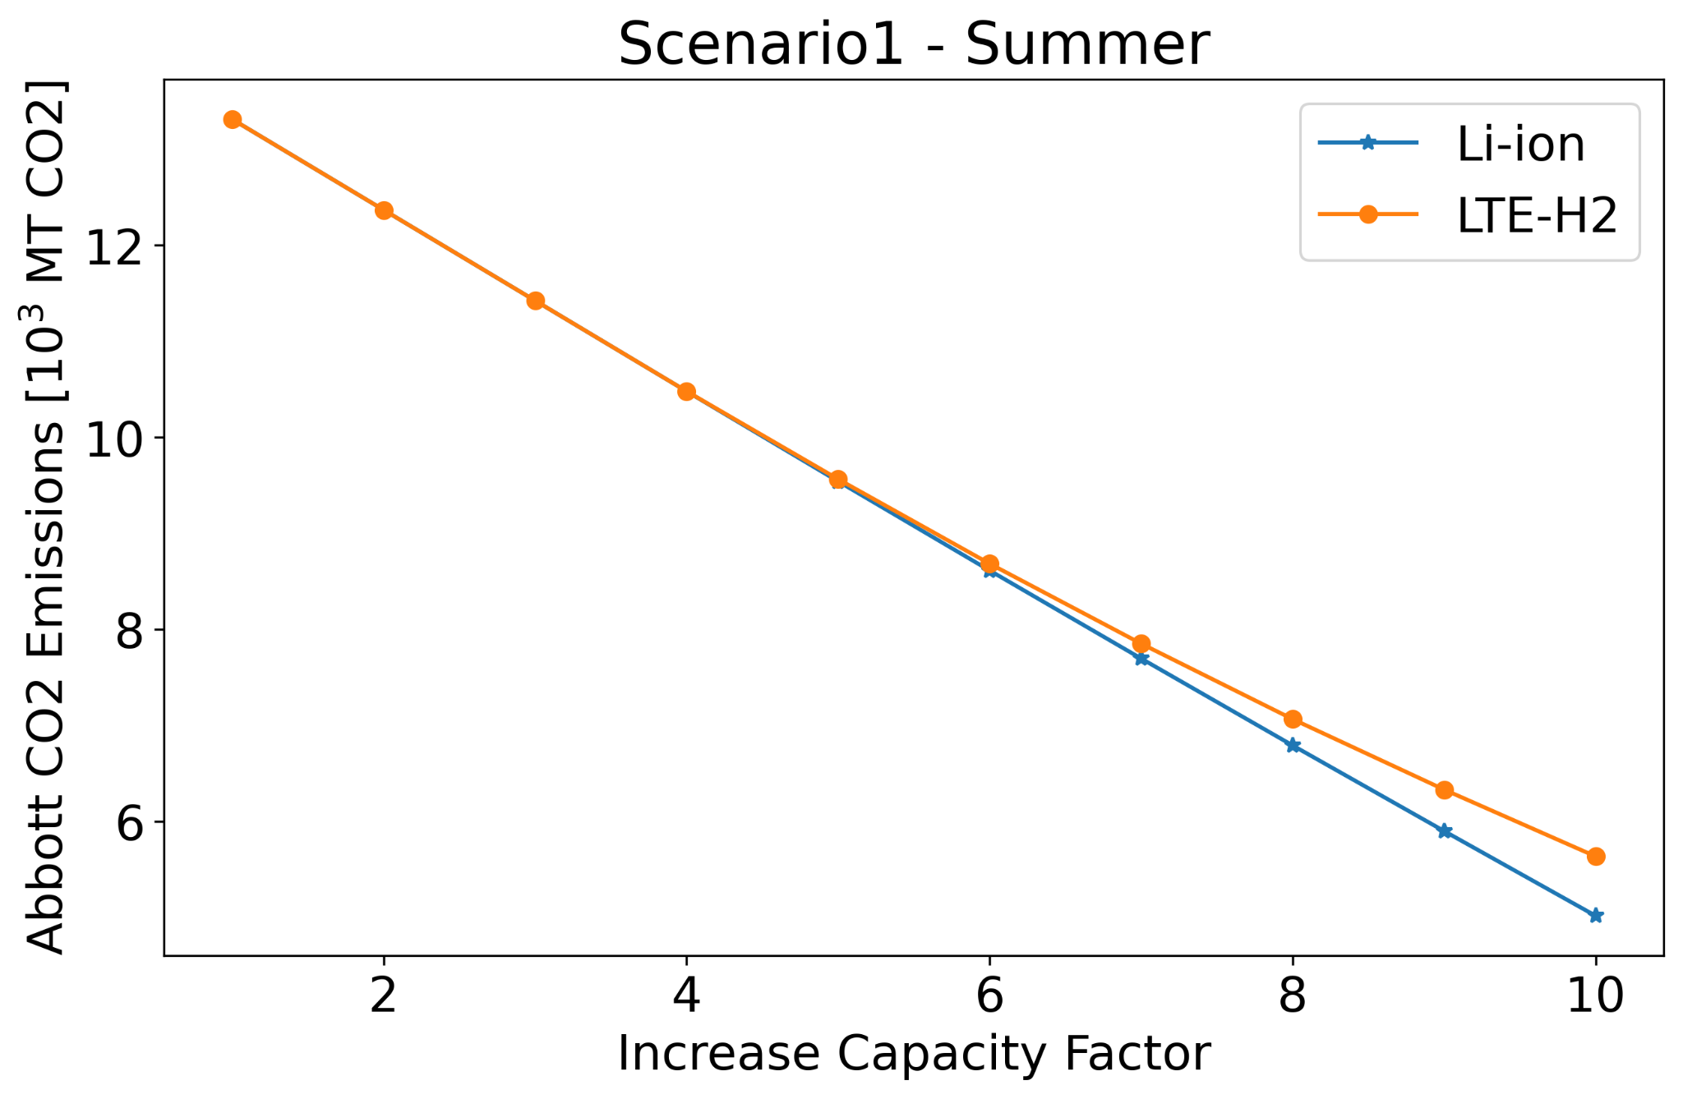
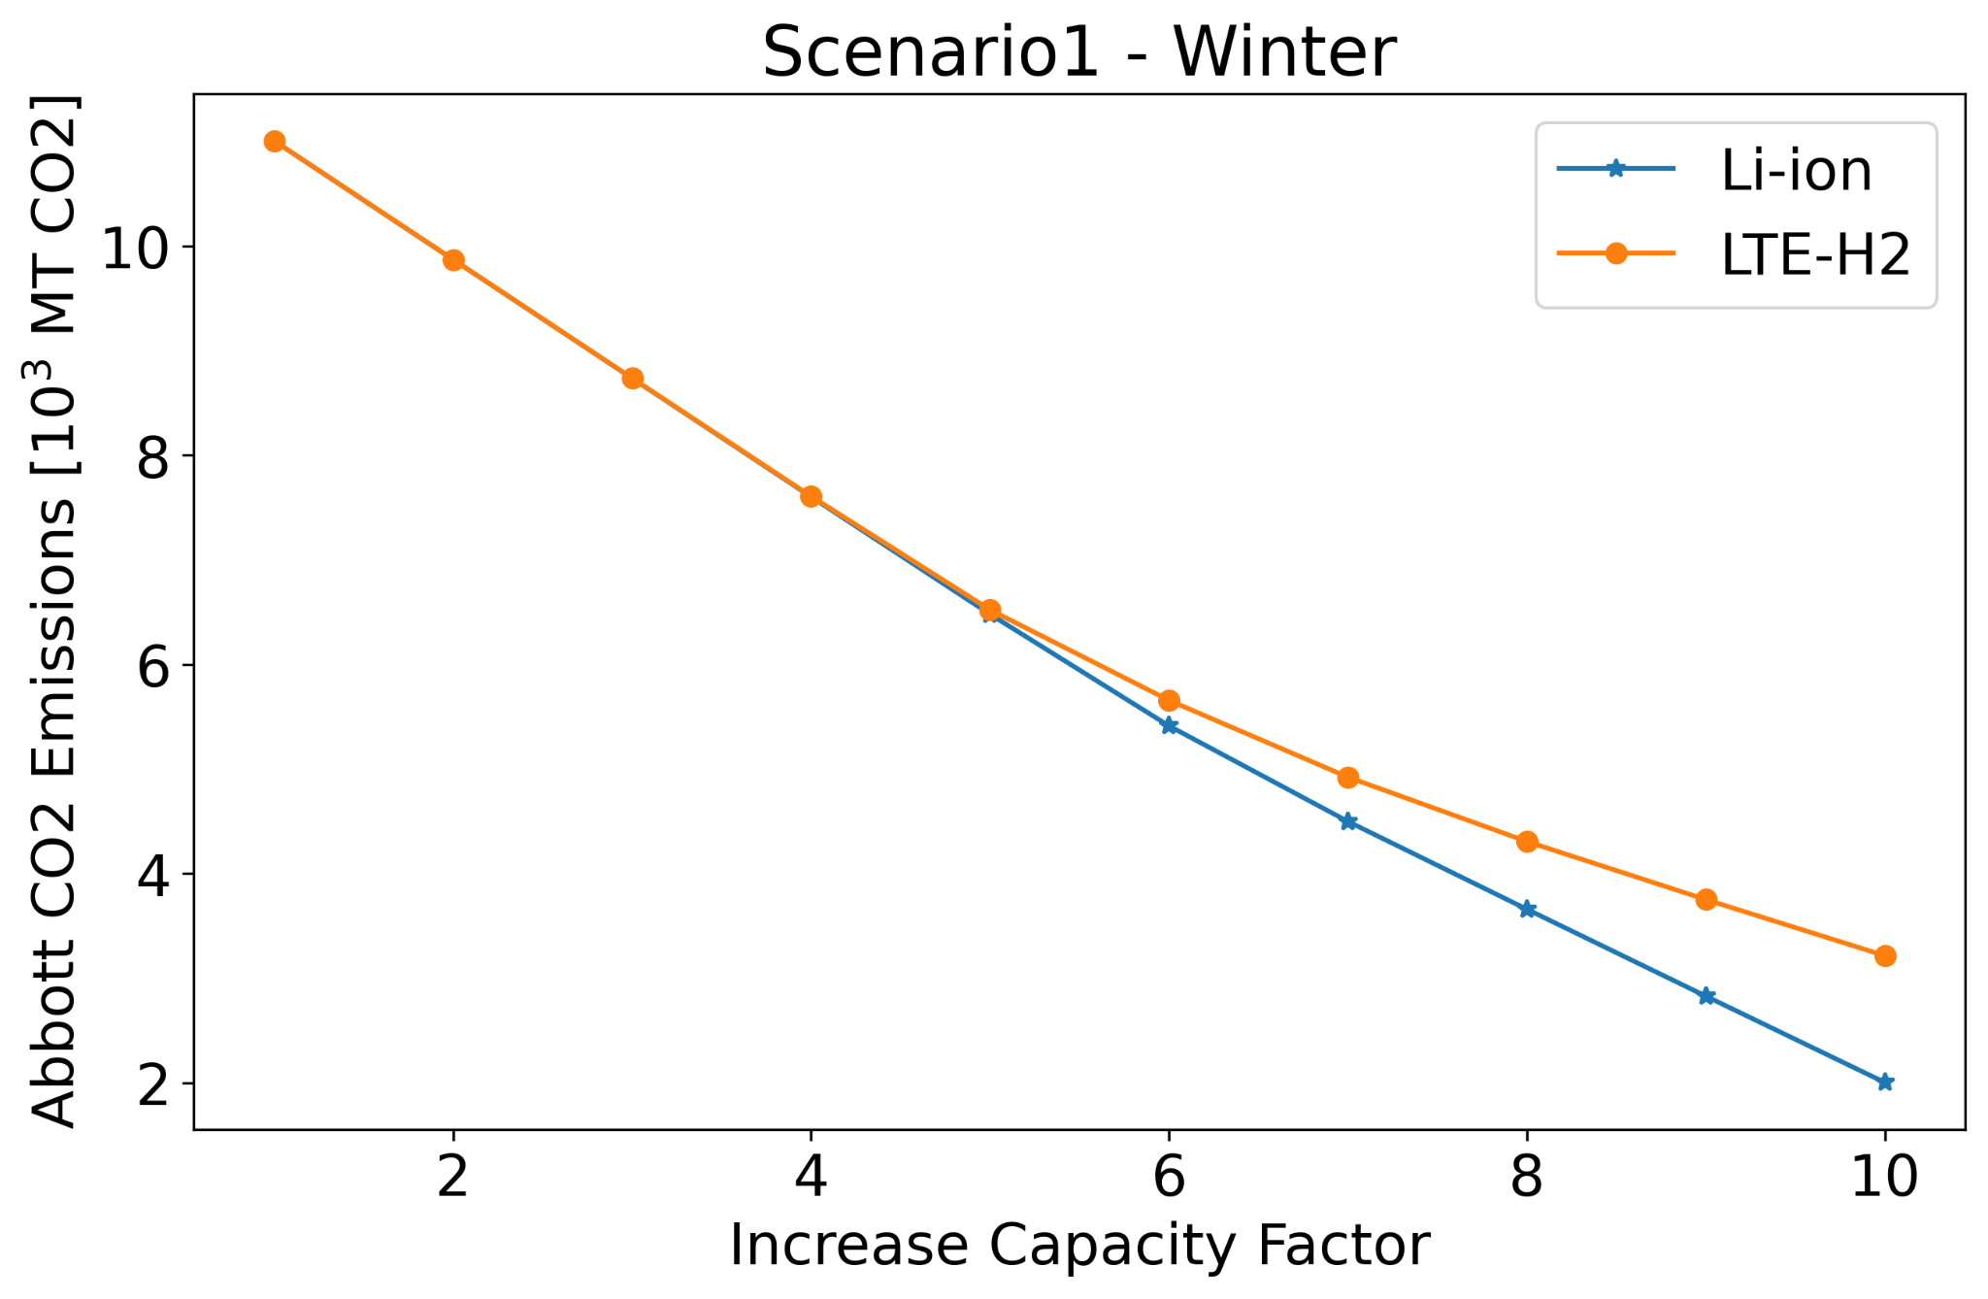
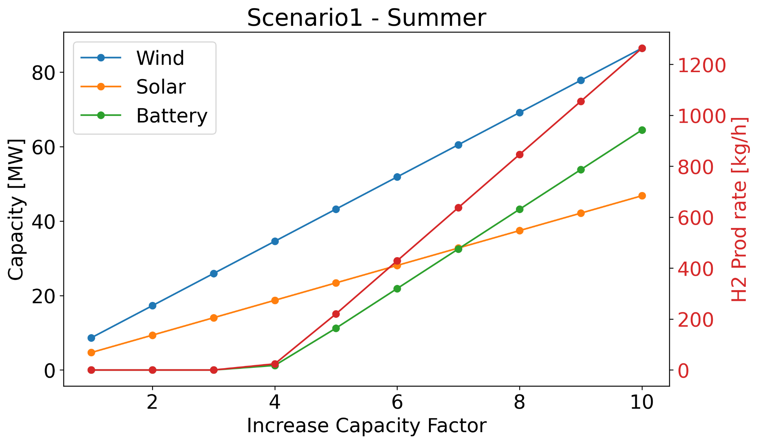
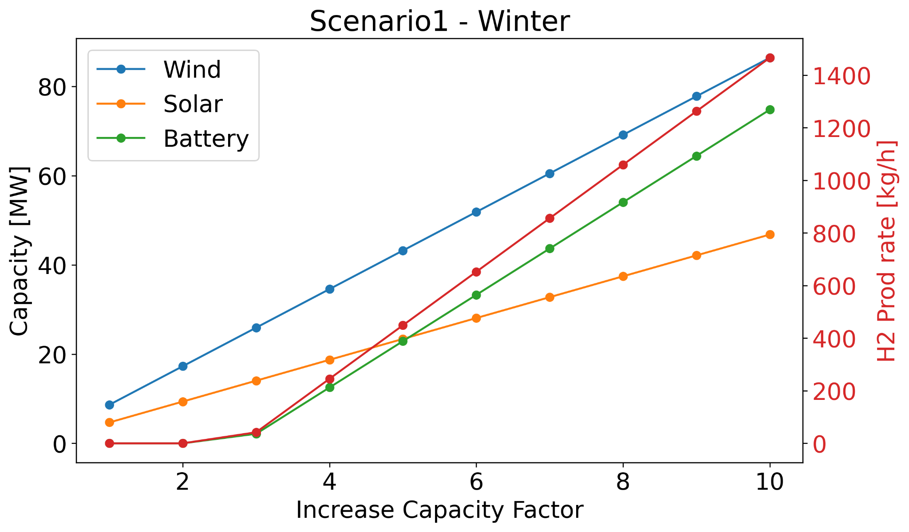
Scenario 1 - Results

Slide 16
Scenario 2
Dispatch model
Wind and Solar
Nuclear Reactor
Storage
Abbott
Import
Increase in Wind and Solar capacity
Increase in Reactor Capacity
Net Demand (ND) = Demand - Wind - Solar - Reactor
Necessity for storage mechanisms
HTE at 3.5 MPa

Slide 17
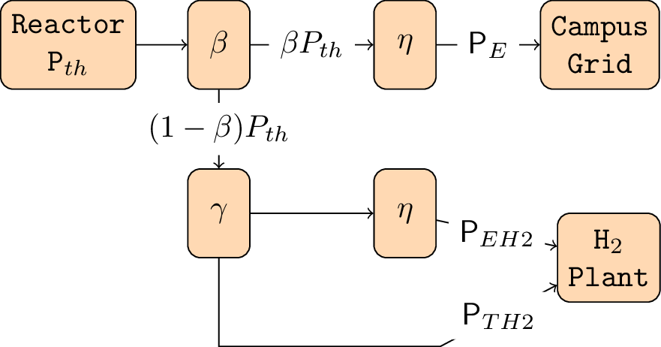
Scenario 2 (2)
PE = 𝜼 𝛽 PTH
PEH2 = 𝜼 𝛄 (1 - 𝛽) PTH
PTH2 = (1 - 𝛄) (1 - 𝛽) PTH
𝜼 = 𝜼(To)
𝜼: conversion efficiency
To: reactor outlet temperature
𝛽 = PE/𝜼 / (PE/𝜼 + PTH2/(1-𝛄))
𝛄 =PEH2/𝜼 / (PEH2/𝜼 + PTH2)
 | 𝛄 | PEH2 | PTH2
LTE | 1 | ≠ 0 | 0
HTE | (0-1) | ≠ 0 | ≠ 0

Slide 18
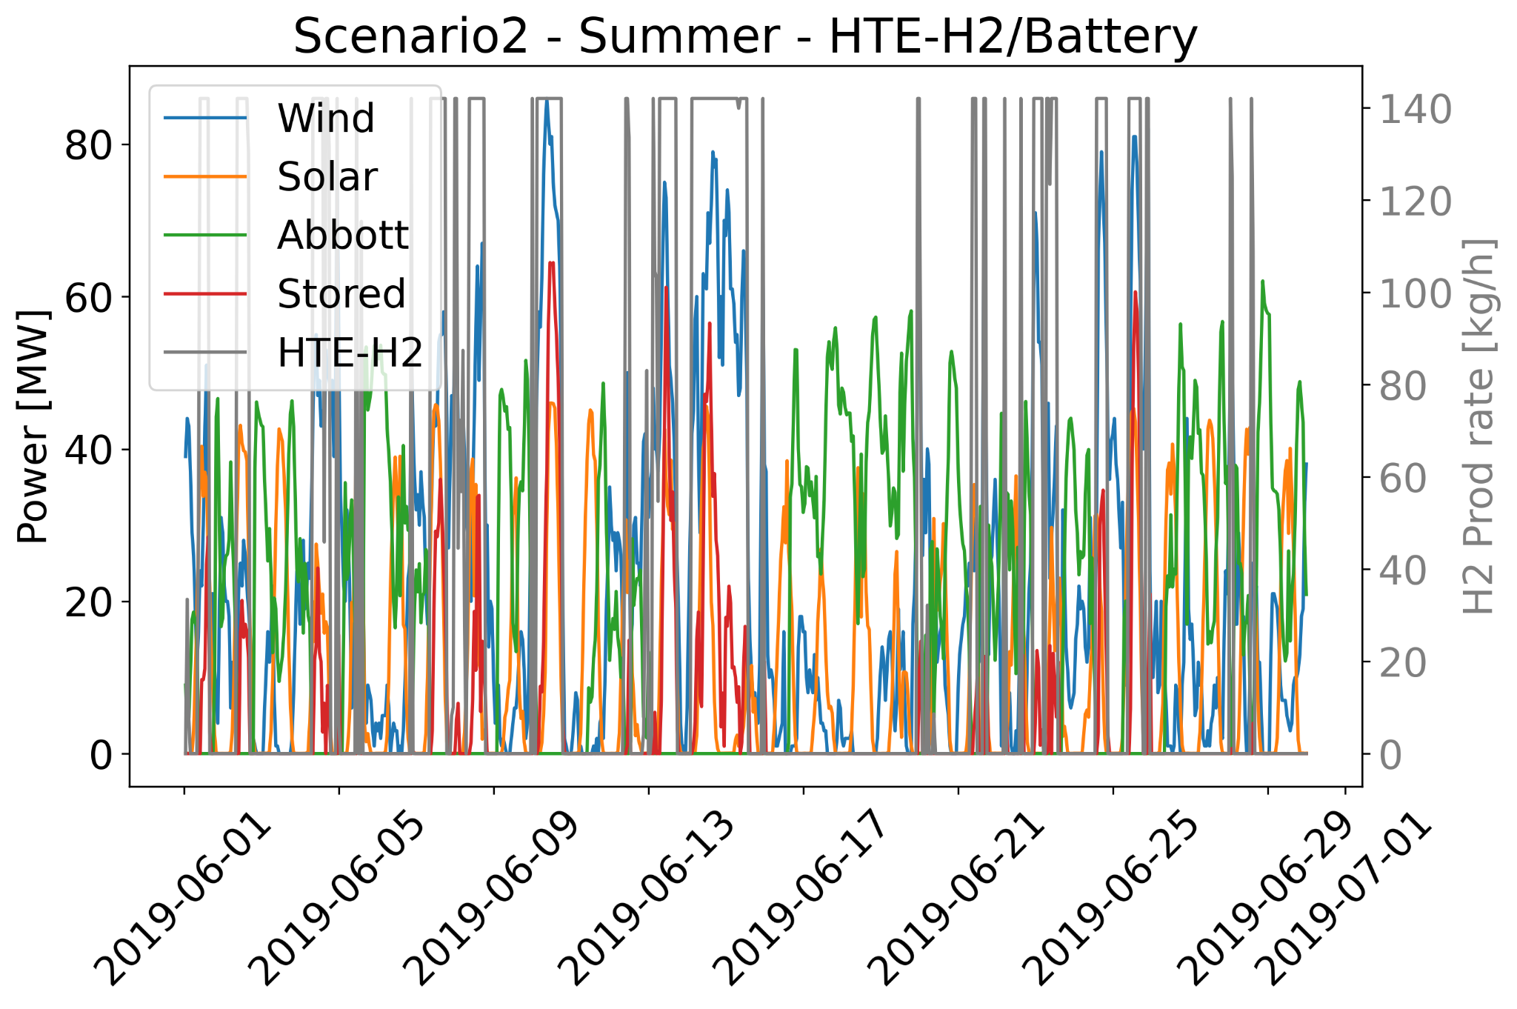
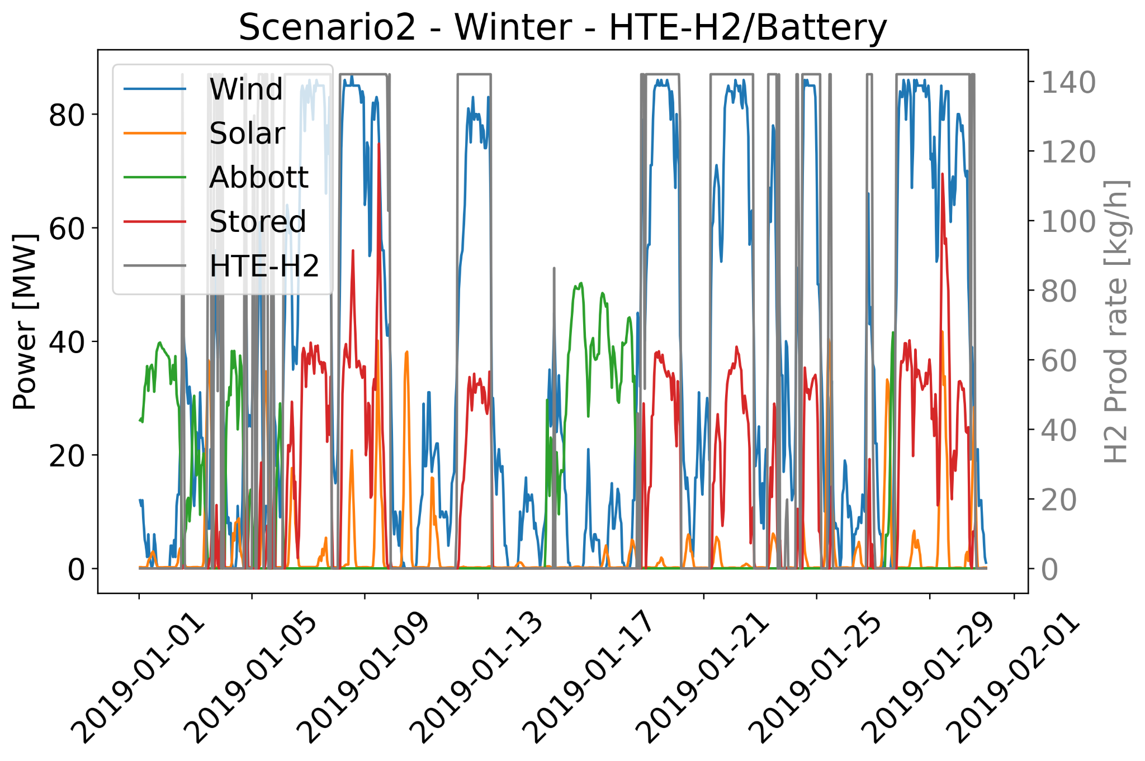
Scenario 2 - Results
Capacity increase by 10, Wind: 100.5 MW, Solar: 46.8 MW, Reactor: 10 MWth

Slide 19
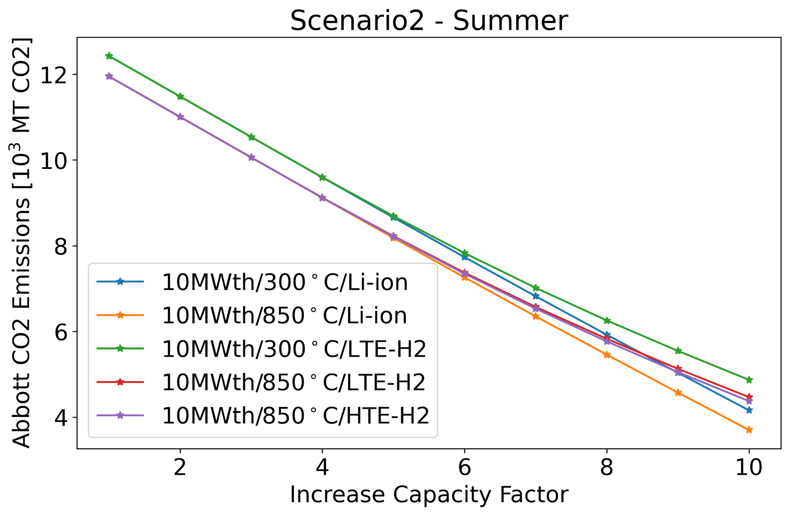
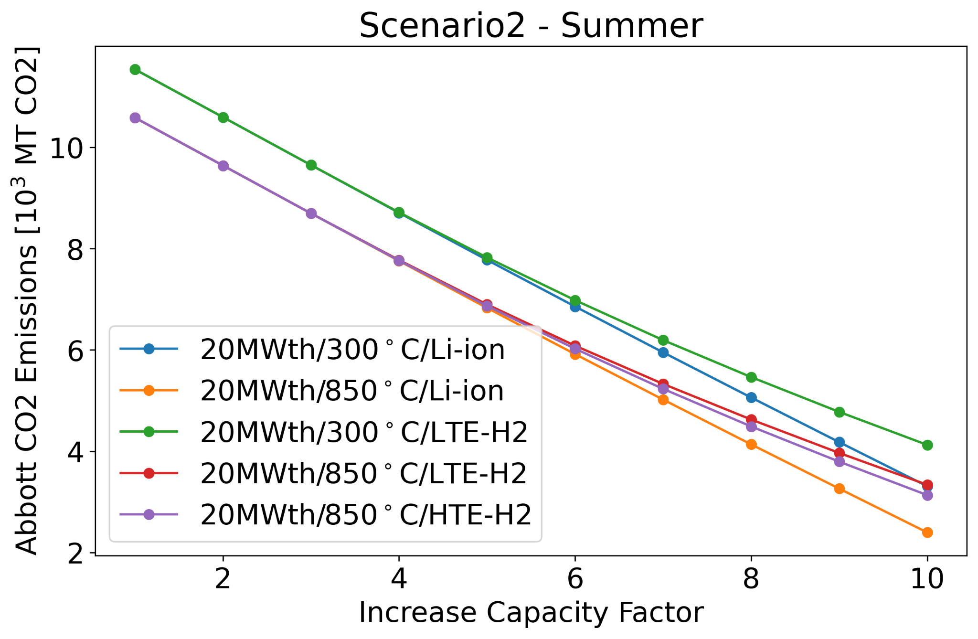
Scenario 2 - Results - Summer

Slide 20
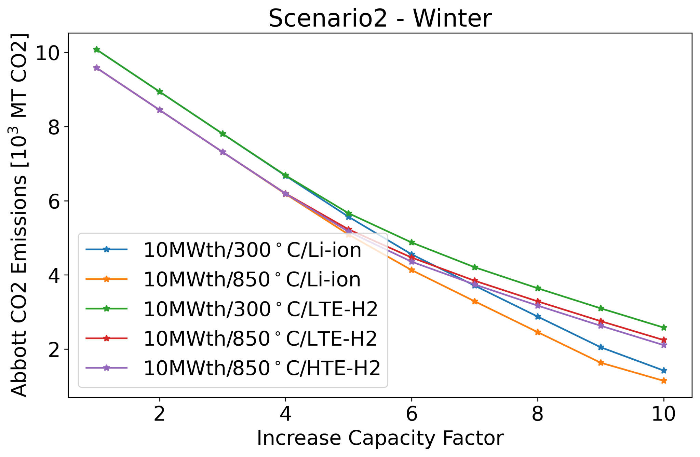
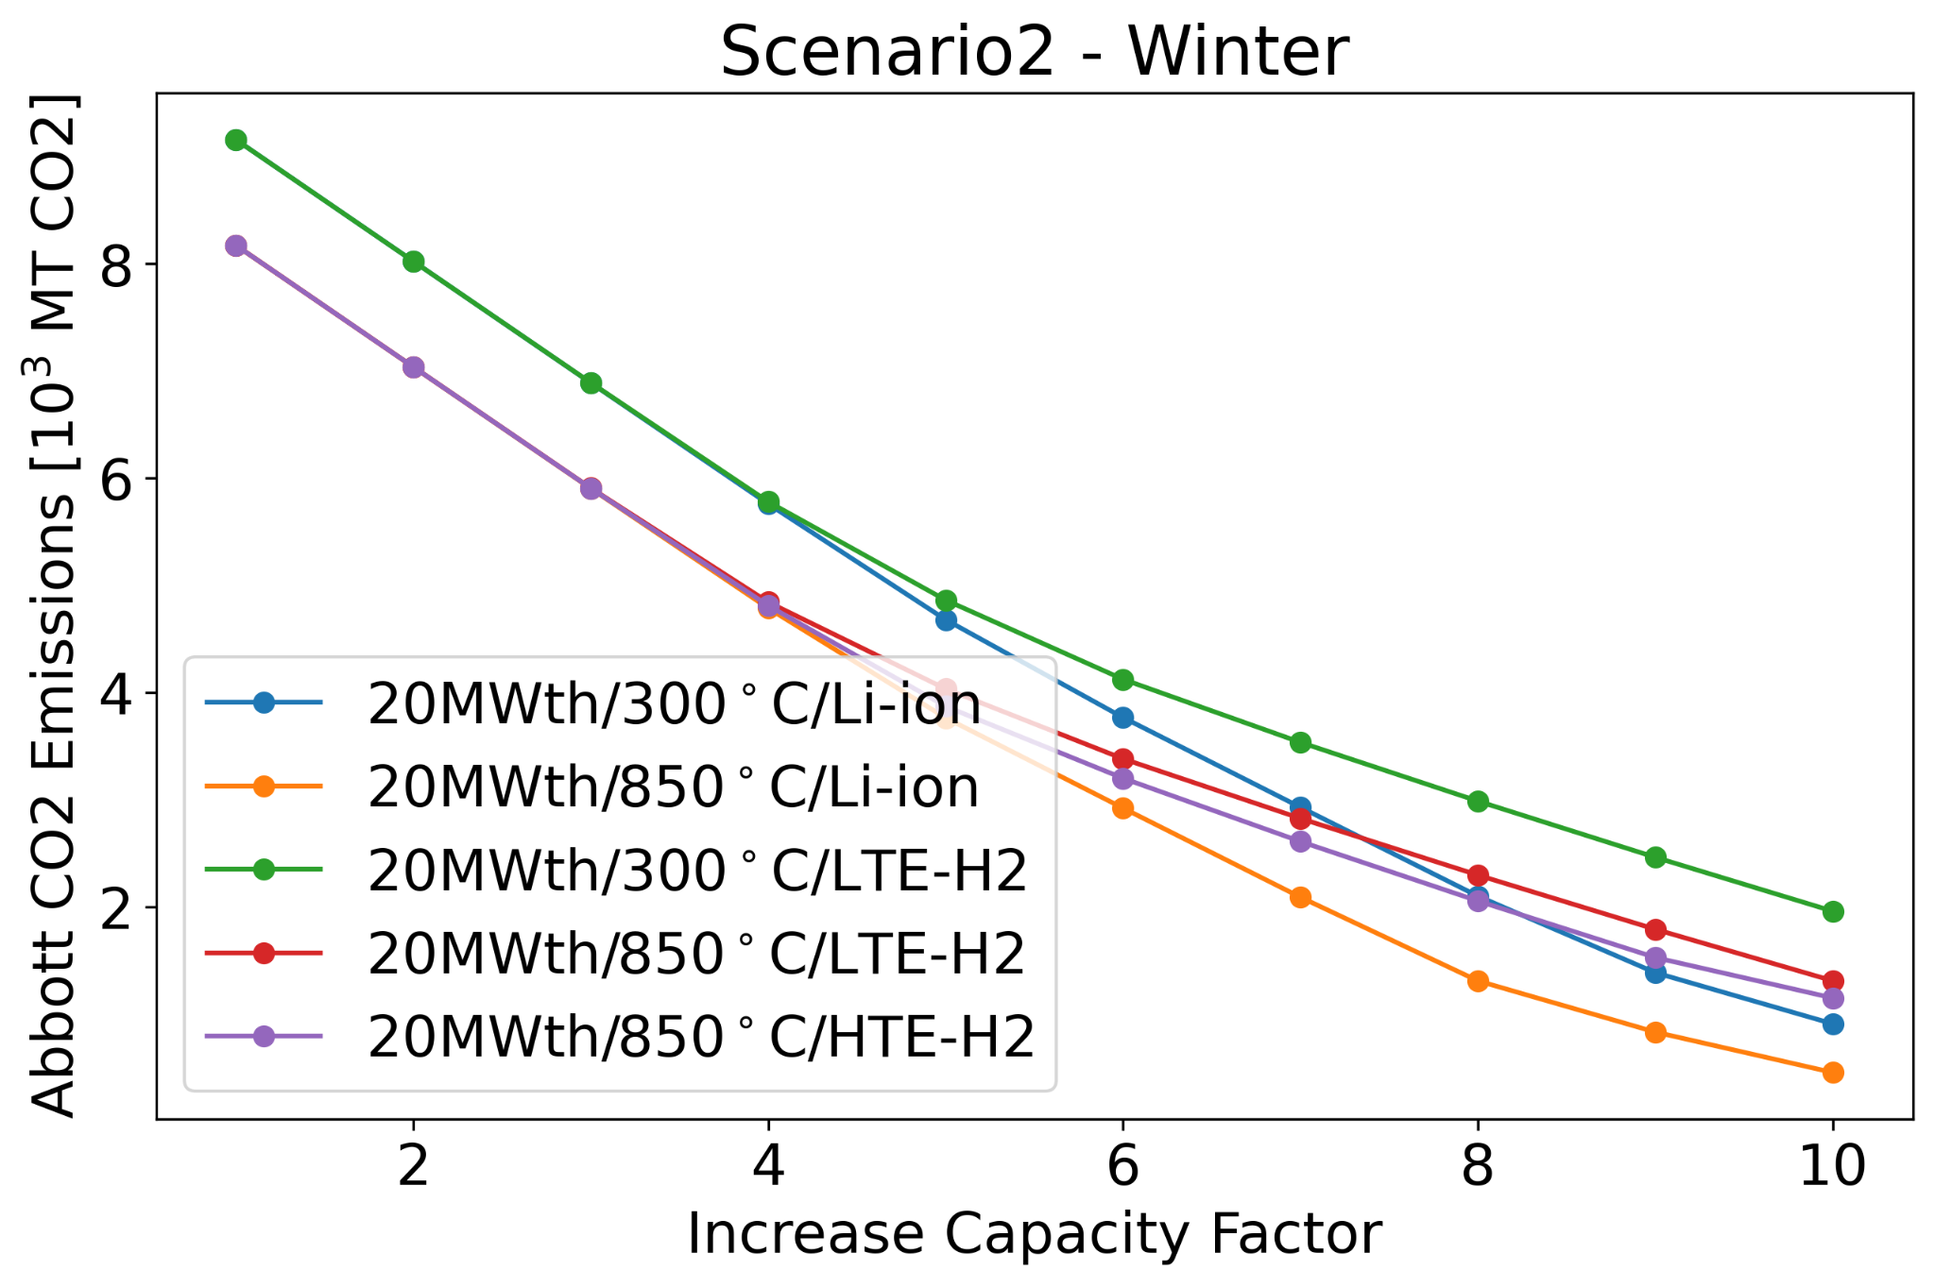
Scenario 2 - Results - Winter

Slide 21
Conclusions
UIUC campus grid is a good example of a diverse microgrid.
Winter CO2 emissions are lower to Summer CO2 emissions.
Total demand is lower as well.
Future work may include the same analysis using February dataset.
Decreasing the imported electricity considerably reduces CO2 emissions.
Abbott steam production may limit max electric capacity.
Increase in renewables capacity linearly decreases CO2 emissions if no storage mechanism is needed.
In Scenario 1, increasing wind and solar capacity requires:
Battery of around 70 MW.
Hydrogen plant that can support 1400 kg/h.
Larger reactor capacities reduce further the CO2 emissions.
Larger reactor outlet temperature increases storage efficiency.
HTE-H2 production is limited by the size of the reactor, secondary method required.
Li-ion is the most efficient storage mechanism.

Slide 22
Acknowledgements
I would like to thank Sam Dotson and Lucas Woodrich for putting together most of the data that was used in this work.
This research was performed using funding received from the DOE Office of Nuclear Energy’s University Program (Project 20-19693, DE-NE0008972) ’Evaluation of micro-reactor requirements and performance in an existing well-characterized micro-grid’.

Slide 23
References
[1] - https://icap.sustainability.illinois.edu/files/project/2634/2015iCAPweb.pdf
[2] - https://icap.sustainability.illinois.edu/files/project/5293/iCAP-2020-FINAL-WEB.pdf
[3] - https://fs.illinois.edu/services/utilities-energy/production/abbott-power-plant
[4] - https://fs.illinois.edu/docs/default-source/utilities-energy/abbottbrofinal.pdf?sfvrsn=90b1f9ea_4
[5] - https://icap.sustainability.illinois.edu/files/project/2235/RailSplitter-Wind%20Farm-9.6.16.pdf
[6] - https://fs.illinois.edu/services/utilities-energy/production/renewable-energy
[7] - https://fs.illinois.edu/docs/default-source/utilities-energy/solar-farm-project-fact-sheet_with-faqs_104171bbba4c36b8160c2ad00ff2500358aeb.pdf?sfvrsn=813ac4ea_0
[8] - https://icap.sustainability.illinois.edu/project/solar-farm-20
[9] - https://www.energy.gov/ne/downloads/ultimate-fast-facts-guide-nuclear-energy
[10] - https://twitter.com/govnuclear/status/1282822874865242117

Slide 24
References (2)
[11] - http://large.stanford.edu/courses/2010/ph240/sun1/
[12] - https://www.ornl.gov/news/new-class-cobalt-free-cathodes-could-enhance-energy-density-next-gen-lithium-ion-batteries
[13] - https://relionbattery.com/blog/the-seven-top-uses-for-rechargeable-lithium-ion-batteries
[14] - https://en.wikipedia.org/wiki/Lithium-ion_battery#Battery_life
[15] - https://www.tesla.com/videos/powerpack-hornsdale?redirect=no
[16] - Fairhurst-Agosta R. MULTI-PHYSICS AND TECHNICAL ANALYSIS OF HIGH-TEMPERATURE GAS-COOLED REACTORS FOR HYDROGEN PRODUCTION. MS Thesis. University of Illinois at Urbana-Champaign. 2020. https://www.ideals.illinois.edu/handle/2142/109439
[17] - UIUC F&S. Private Communications. 2019. 2020.

Slide 25
Thank you!
Questions?

